Slide 1
Attributes and Methods in Python File Handling.
An over-view of How Python Interacts with Files
Presented by: Urja Kothwala
24MSBI133

Slide 2
Introduction to File Handling in Python
In Python, file handling refers to the process of opening, reading, writing, and closing files stored on your computer.
It allows you to interact with external data sources like .txt, .csv, or .json files.
Why it's important:
You can store data permanently instead of just using temporary variables.
Useful for real-world applications like log files, data storage, report generation, and configuration reading.
Python provides a built-in function open() to access a file. Depending on the mode ('r', 'w', 'a', etc.), you can:
Read from the file
Write new content
Append to existing content
After performing actions, you should always close the file using close() to free up system resources.

Slide 3
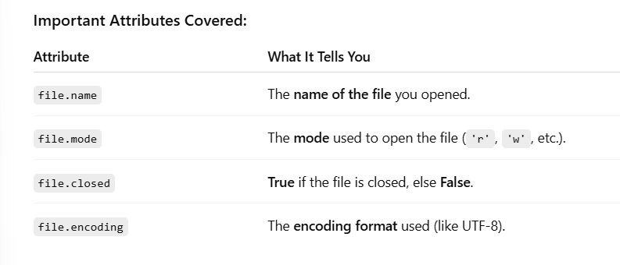
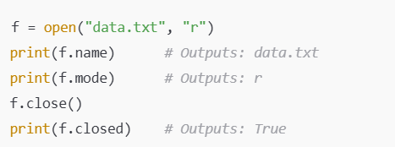
What Are Attributes?
Attributes are the built-in properties of a file object in Python.Once a file is opened using the open() function, the file object contains useful information (attributes) that describes the file, such as its name, the mode in which it was opened and whether it is closed.
They are not functions—you don’t call them with parentheses.
Attributes give descriptive information about the file object.

Slide 4
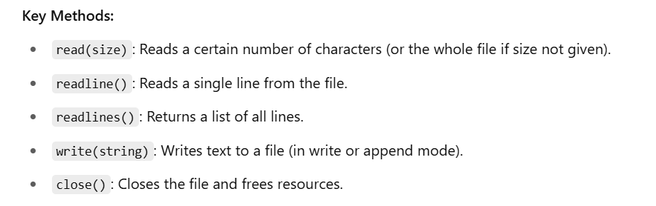
What are methods?
Methods are Built-in functions associated with file objects in python. Methods lets you perform operations like reading, writing, and closing the file.

Slide 5
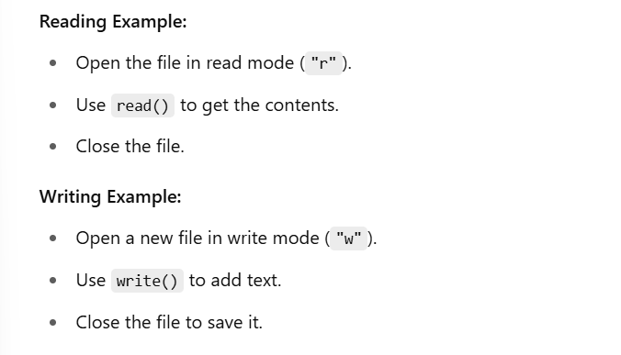
Read and Write Example

Slide 6
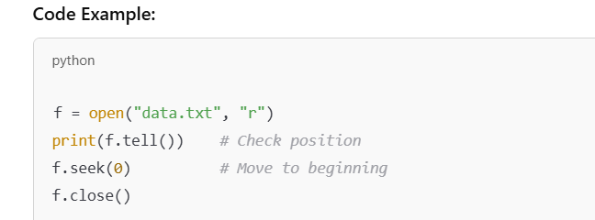
File Cursor Method- Controlling the file Cursor in Python
When we open and read a file in Python, the system keeps track of where we are in the file using something called the file cursor—also known as the file pointer.
Two important methods help us manage this:
🔹 tell() – This method tells us the current position of the cursor, in bytes, from the beginning of the file.
It’s useful for tracking or debugging file operations.
🔹 seek(position) – This method moves the cursor to a specific byte position. For example, seek(0) moves it to the beginning of the file.
These methods become especially helpful when working with large files or when we want to re-read or overwrite
specific parts without reloading the whole file.

Slide 7
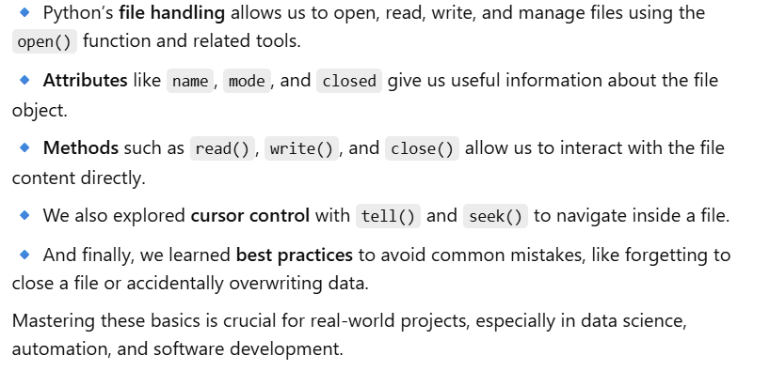
Summary

